Slide 1
Calendar in C -Alfian Nurshadiq (1706018896) -Kevin (1706064694)

Slide 2
This program is used to show the calendar in which the user can insert, edit, or delete the schedule based on what he/she wants. When done, the date inserted by the schedule will be highlighted.

Slide 3
This program use header to divide the file into two part: main program in .c and the library in .h to save the function to be used by the main program

Slide 4
MAIN PROGRAM (.c)

Slide 5
This part is used to define the current date, month, and year which is provided by the library of time.h. Then, those variable (integer) is converted into string.

Slide 6
This part is made to be the instruction of this whole program to make it user-friendly.

Slide 7
This part is used as the option to be chosen by the user: -’N’ is used to view the next month -’ P’ is used to view the previous month -’G’ is used to go to the specific month in the calendar -’S’ is used to show event(s) for a specific date -’I’ is used to insert the new date -’D’ is used to delete the event -’Q’ is used to quit the program

Slide 8
LIBRARY OF THE FUNCTION (.h)

Slide 9
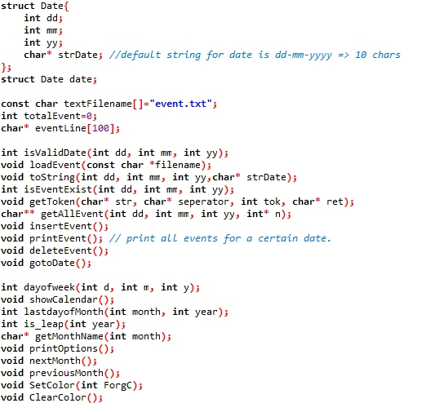
The first part of this .h file is filled by defining the function that we want to used to use in this program.

Slide 10
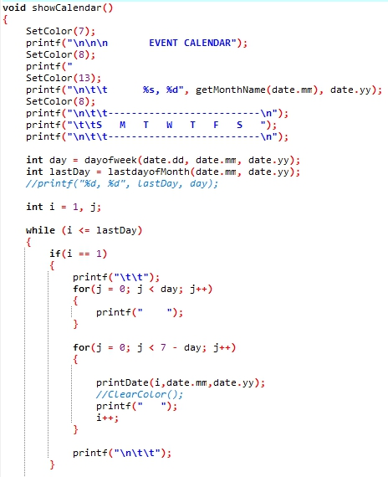
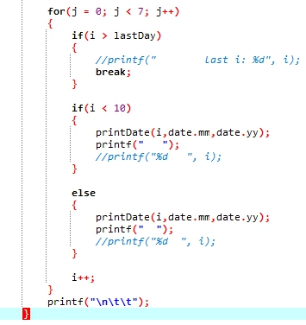
This function is used as the main part to show the calendar when we firstly run the program until we insert or modify the schedule and then quit the program.
(1)
(2)

Slide 11

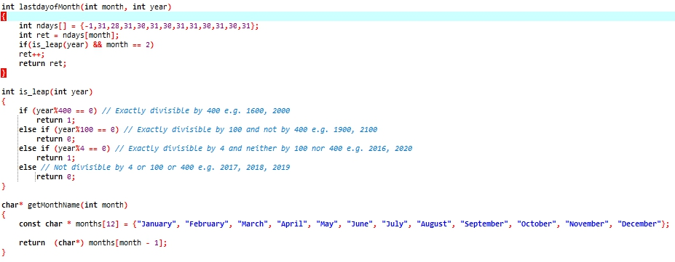
Those function is used inside the function of showCalendar(). The dayofweek() is used to show the day in the week. lastdayofMonth() is used to show the last day of the month which is determined by whether the year is leap or not using is_leap() function. If the year is leap, then the last day in February will be 29. Instead, it will be 28. getMonthName() is used to shot the name of the month.

Slide 12
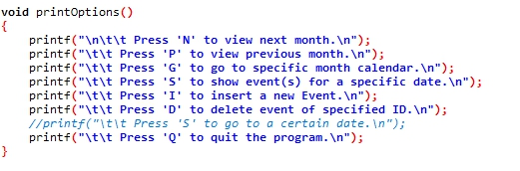
printOptions() is only used to print the instruction about how to use the main program by pressing the keyboard.

Slide 13
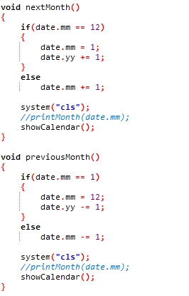
The nextMonth() is a function used to show the next month and previousMonth() is used to show the previous. When the calendar show the twelfth month, it will show the next year if the nextMonth() is run. Instead, the calendar will show the previous year if the calendar show the first month when previousMonth() is run.

Slide 14
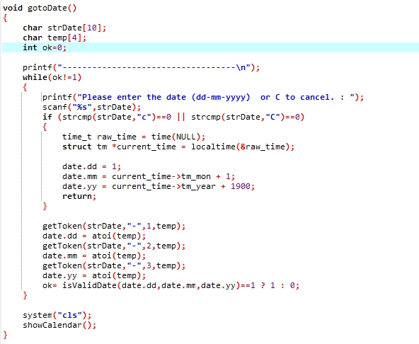
gotoDate() is used to go to the specific date based on what the user want. This function will find that date based on the token using the getToken() function.

Slide 15
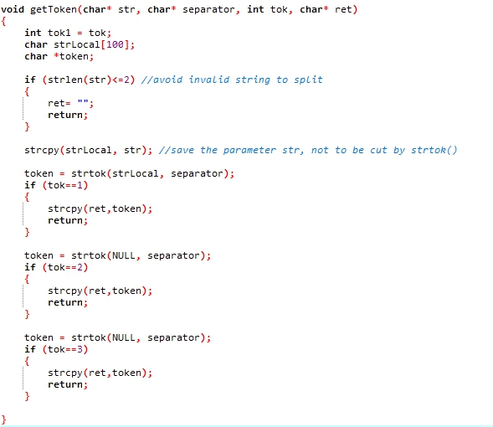
This function is used to get the data in database such as ID, date, and the event which separated by semicolon (;)

Slide 16
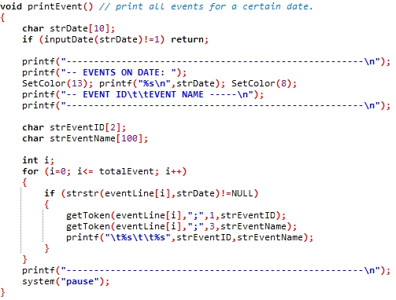
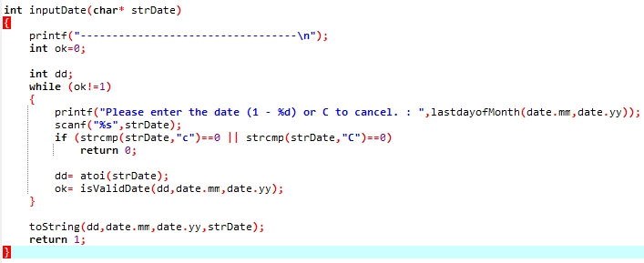
The printEvent() function is used to show the event inserted by the user before. Before that, the user is asked to input the date using inputDate() function.

Slide 17
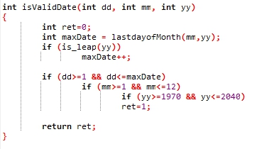
This function is used inside many other function. This function will check whether the date inputted by the user is valid or not.

Slide 18
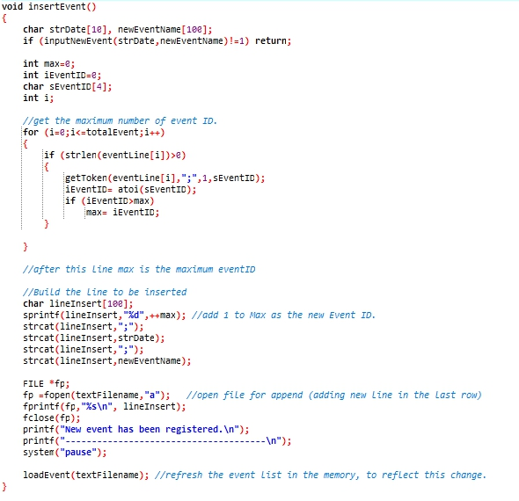
insertEvent() is used to insert the event on the specific date which is determined by the user into the file. Previously, the user is asked to write the event using the inputNewEvent() function.

Slide 19
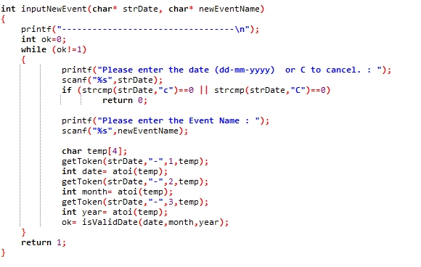
This function is used to ask the user to input the event so that it will be saved to the file using the insertEvent() function.

Slide 20
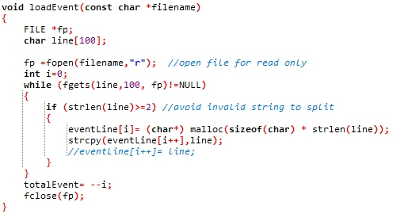
This function is used to refresh the event list in the memory in order to reflect this change

Slide 21
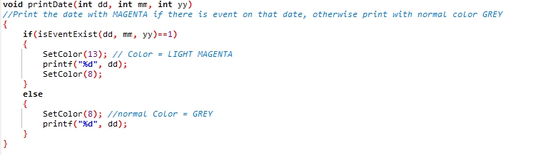
After the event is inserted, then the date on the calendar will be highlighted by changing the color of it using the printDate() function. The color is changed using SetColor() function.

Slide 22
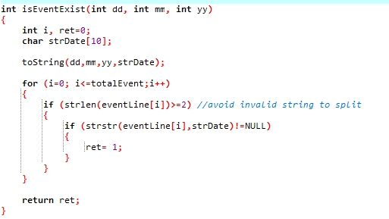
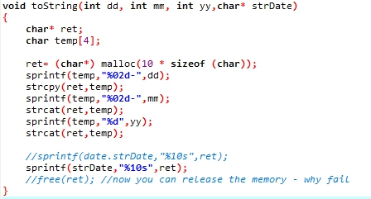
isEventExist() is used in printDate() function to check whether the event of the date that will be highlighted is exist or not. toString() is used to convert the date from integer to string

Slide 23
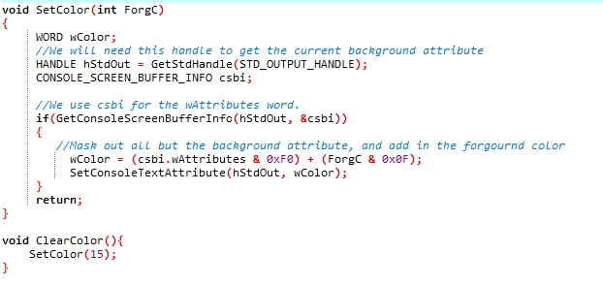
SetColor() function is used inside many other function to change the color of the date to highlight it on the calendar showed in the main interface. ClearColor() is used to return the color of the highlighted date into default.

Slide 24
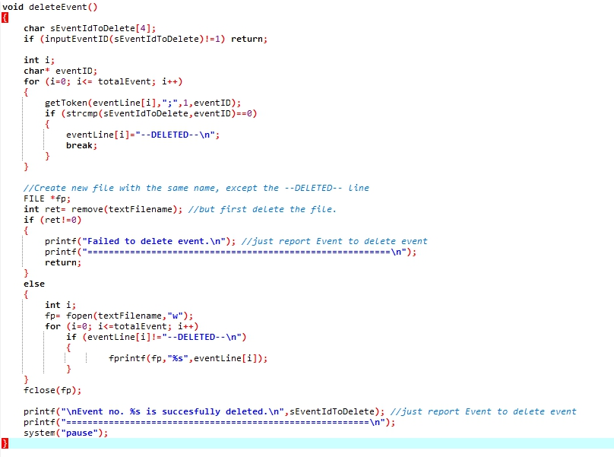
This function is used to delete the event inserted by the user previously

Slide 25
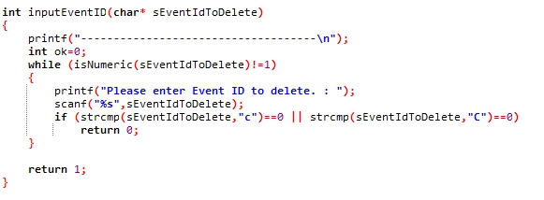
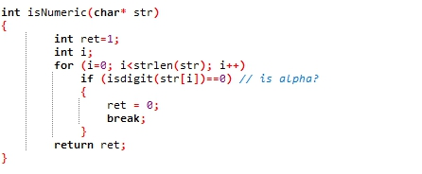
Those function is used inside the deleteEvent() function. The function is to check whether the event is exist in the file or not. Then, isNumeric() is used to check whether the ID is numeric or not.

Slide 26

How it works (Text File)
This application uses text file to save the data.
We can see from the text above that there is a certain format to this format. That is Token:Date:Event
We used this format as it will be easier for us to identify certain events and will be easier for us to edit these events. We can use strtok() function in string.h to get the text before “;”.

Slide 27
How it works (Text File)
In the program, there is a function called loadEvent that will read the text file and insert it into a buffer. Thus we only have to read the file once, any edits (delete or add) will be affected on the buffer.
This buffer once done being edited (delete or add) will then be inserted or overwrite the existing data in the text file. Then the program will call loadEvent once again to refresh the buffer.

Slide 28
How it works (Structure)
We also used structure in our application to keep the current date. This includes the day, month and year and also the date in string.
We did this so the showCalendar function will not require any parameter and will always rely on the structure for changes.
The functions like nextMonth, previousMonth and gotoDate changes the data in the structure and thus will change when showCalendar is executed.

Slide 29
How it works (Calendar)
Once the program is run, the first thing that the program will do is load the buffer with the text file and initialize the structure date with the current date except for the day. The day will be set to 1.
This is to display the calendar correctly as the function showCalendar uses the day to get the start of the week by calling the function dayofweek. This will return which day it is or more specifically a number which will represent the day of the week (e.g 0 is for Sunday).
We also used the function lastdayofMonth to get the days of a month as this varies for each month (it may also be a leap year).

Slide 30
References
https://www.geeksforgeeks.org/find-day-of-the-week-for-a-given-date/
https://www.codewithc.com/mini-project-in-c-calendar/
https://bytes.com/topic/c/answers/220599-ldom-last-day-month
https://stackoverflow.com/questions/24696113/how-to-find-text-between-two-strings-in-c

Slide 31
Github
https://github.com/Alfihz/Application

